Slide 1
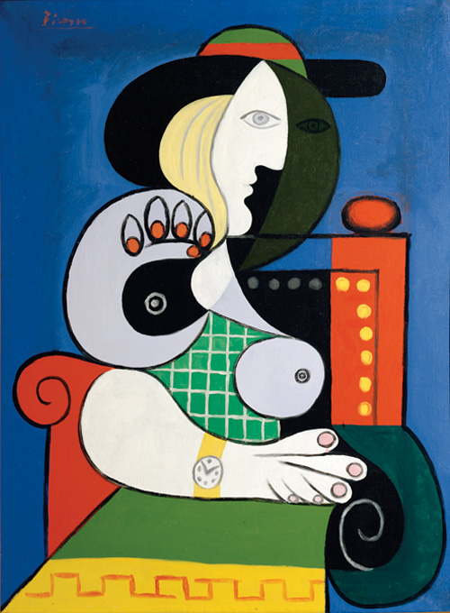
art in the style of……
Pablo Picasso!

Slide 2
LO: To record from first-hand observation, experience and imagination, and explore ideas.

Slide 3
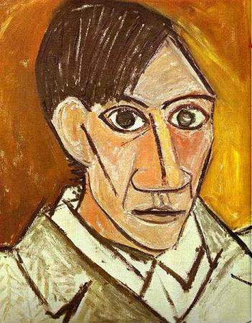
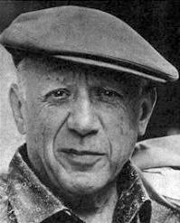
Pablo Picasso was Spanish
He lived between 1881 & 1973

Slide 4
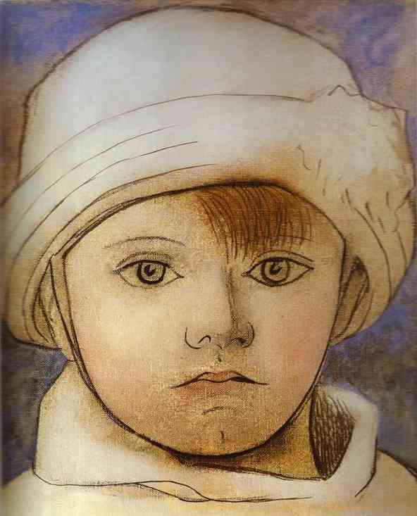
Picasso drew/painted many portraits in his life.
This is Picasso’s
son Paul as a
child

Slide 5
This is a self
portrait

Slide 6
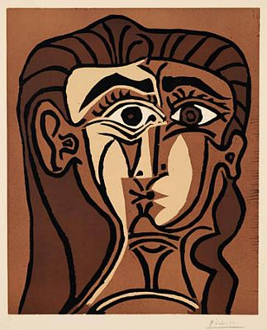
Oh dear!

Slide 7
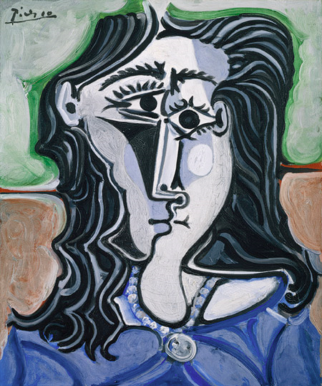
Today you’re going
to draw like
this!

Slide 8
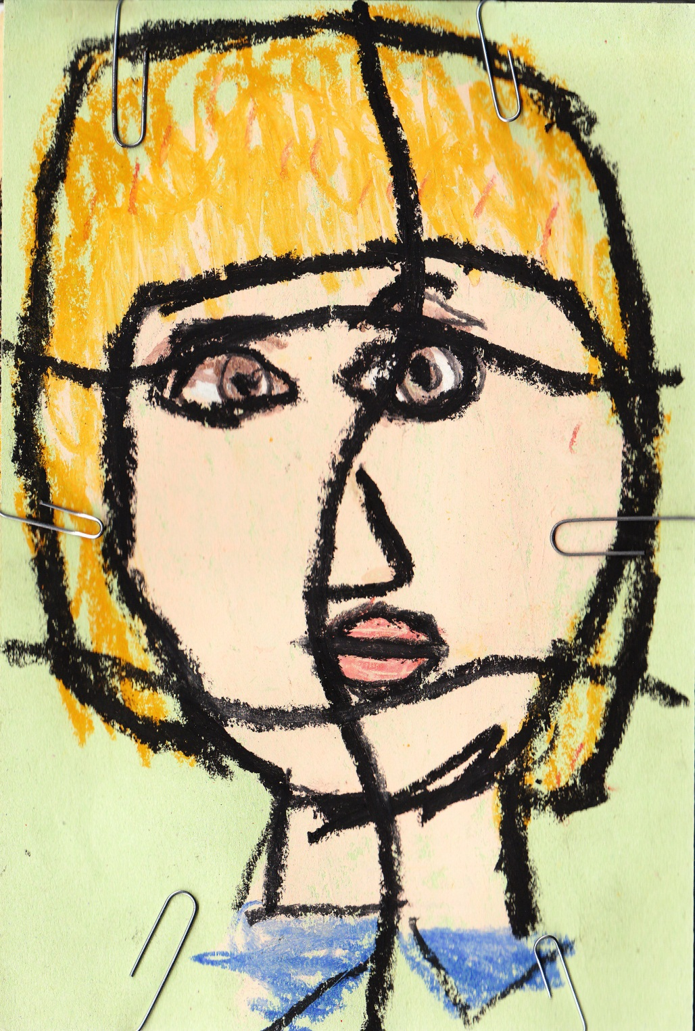
Paper clips
Cut along lines

Slide 9
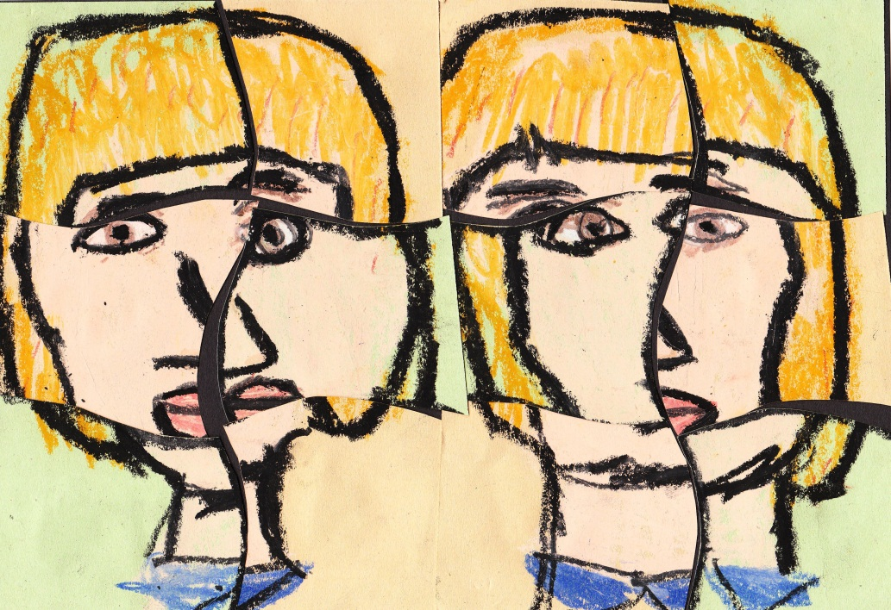
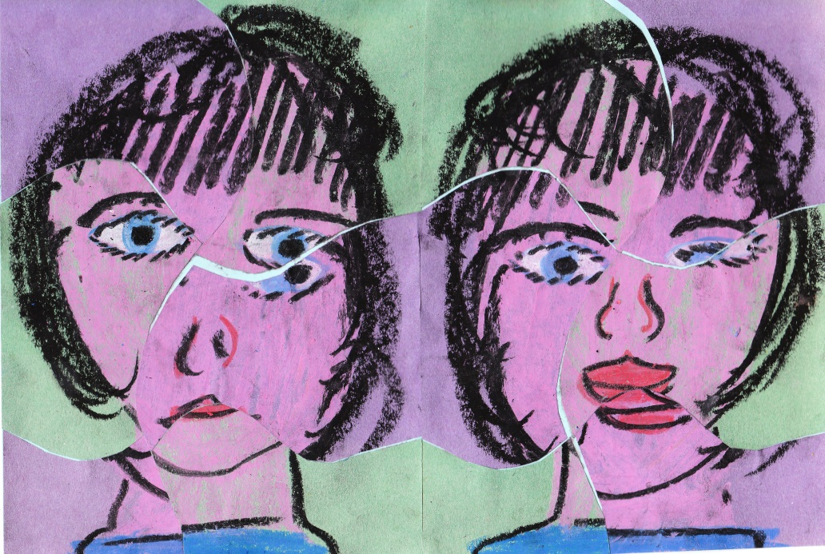
This is what
Your
“Picasso-style” portrait will look like!

Slide 10
What you need to do:
Get into pairs
Draw 2 portraits of your partner from the neck up
(using wax crayons or pastels)
Place the 2 portraits together & cut as shown
Cut into 6 pieces
Stick pieces together on coloured paper
You can be imaginative with the colours you use when drawing, look at Picasso’s!

